Slide 1
Lecture #10: Boosting & Stacking and an Introduction to Neural Network

Slide 2
ANNOUNCEMENTS
HW5 is posted and due Tues night at 11:59pm (July 28)
The Final Exam (individual work) will be posted July 27 (Monday) and due Monday, Aug. 3. It is cumulative and will be more open-ended. More details coming on Monday.
Friday’s lab will be very useful for implementing Neural Networks for the HW.

Slide 3
Outline
Review of Ensemble Methods
Boosting
Set-up and intuition
Connection to Gradient Descent
The Algorithm
Stacking
Artificial Neural Networks: an introduction
Anatomy of a NN
NN Design choices

Slide 4
Review of Ensemble Methods (Bagging and Random Forests)

Slide 5
Bags and Forests of Trees
Last time we examined how the short-comings of single decision tree models can be overcome by ensemble methods - making one model out of many trees.
We focused on the problem of training large trees, these models have low bias but high variance.
We compensated by training an ensemble of full decision trees and then averaging their predictions - thereby reducing the variance of our final model.

Slide 6
Bags and Forests of Trees (cont.)
Bagging:
create an ensemble of full trees, each trained on a bootstrap sample of the training set;
average the predictions
Random forest:
create an ensemble of full trees, each trained on a bootstrap sample of the training set;
in each tree and each split, randomly select a subset of predictors, choose a predictor from this subset for splitting;
average the predictions
Note that the ensemble building aspects of both method are embarrassingly parallel!

Slide 7
Motivation for Boosting
Could we address the shortcomings of single decision trees models in some other way?
For example, rather than performing variance reduction on complex trees, can we decrease the bias of simple trees - make them more expressive?
A solution to this problem, making an expressive model from simple trees, is another class of ensemble methods called boosting.

Slide 8
Boosting Algorithms

Slide 9
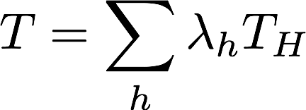
Gradient Boosting
The key intuition behind boosting is that one can take an ensemble of simple models {T_{h}}_{h∈H} and additively combine them into a single, more complex model.
Each model T_{h} might be a poor fit for the data, but a linear combination of the ensemble
can be expressive/flexible.
But which models should we include in our ensemble? What should the coefficients or weights in the linear combination be?

Slide 10
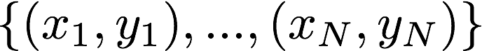
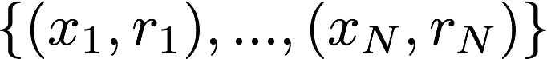
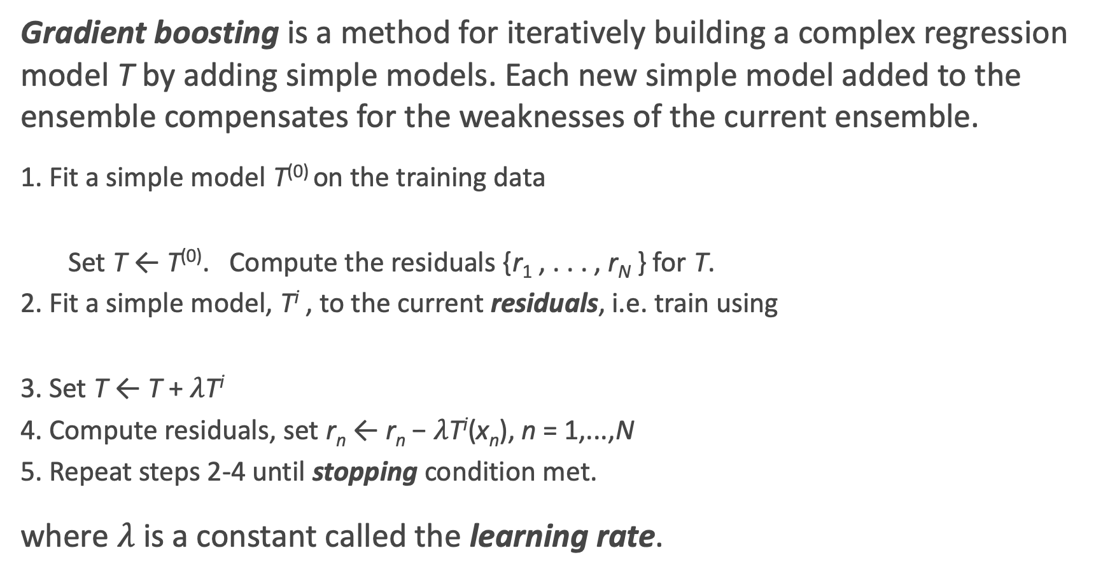
Gradient Boosting: the algorithm
Gradient boosting is a method for iteratively building a complex regression model T by adding simple models. Each new simple model added to the ensemble compensates for the weaknesses of the current ensemble.
1. Fit a simple model T⁽⁰⁾ on the training data
Set T ← T⁽⁰⁾. Compute the residuals {r₁ , . . . , r_{N} } for T.
2. Fit a simple model, T^{i} , to the current residuals, i.e. train using
3. Set T ← T + $λ$T^{i}
4. Compute residuals, set r_{n} ← r_{n} − $λ$T^{i}(x_{n}), n = 1,...,N
5. Repeat steps 2-4 until stopping condition met.
where $λ$ is a constant called the learning rate.

Slide 11
Gradient Boosting: illustration (0)

Slide 12
Gradient Boosting: illustration 1

Slide 13
Gradient Boosting: illustration 2

Slide 14
Gradient Boosting: illustration 3

Slide 15
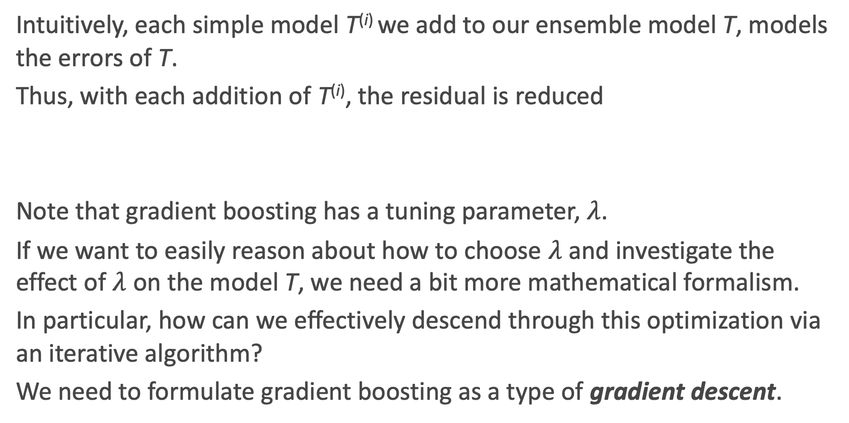
Why Does Gradient Boosting Work?
Intuitively, each simple model T^{(i)} we add to our ensemble model T, models the errors of T.
Thus, with each addition of T^{(i)}, the residual is reduced
Note that gradient boosting has a tuning parameter, $λ$.
If we want to easily reason about how to choose $λ$ and investigate the effect of $λ$ on the model T, we need a bit more mathematical formalism.
In particular, how can we effectively descend through this optimization via an iterative algorithm?
We need to formulate gradient boosting as a type of gradient descent.

Slide 16
Review: A Brief Sketch of Gradient Descent
In optimization, when we wish to minimize a function, called the objective function, over a set of variables, we compute the partial derivatives of this function with respect to the variables.
If the partial derivatives are sufficiently simple, one can analytically find a common root - i.e. a point at which all the partial derivatives vanish; this is called a stationary point.
If the objective function has the property of being convex, then the stationary point is precisely the min.

Slide 17
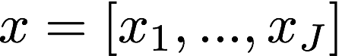
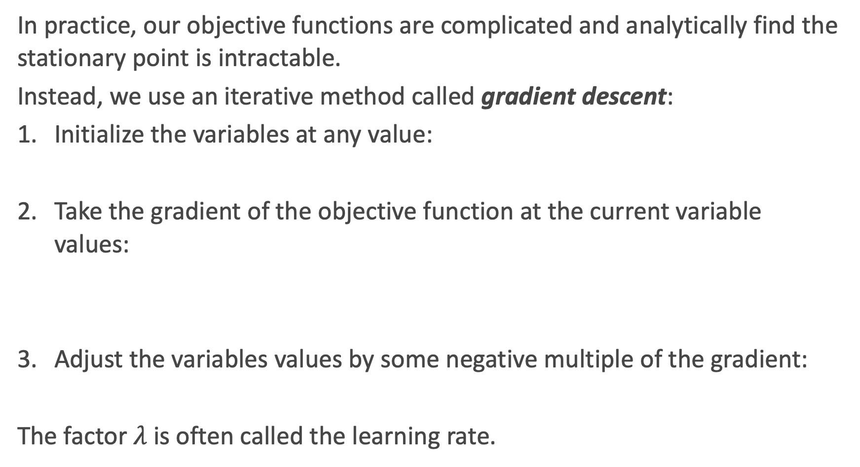
Review: A Brief Sketch of Gradient Descent the Algorithm
In practice, our objective functions are complicated and analytically find the stationary point is intractable.
Instead, we use an iterative method called gradient descent:
Initialize the variables at any value:
Take the gradient of the objective function at the current variable values:
Adjust the variables values by some negative multiple of the gradient:
The factor $λ$ is often called the learning rate.

Slide 18
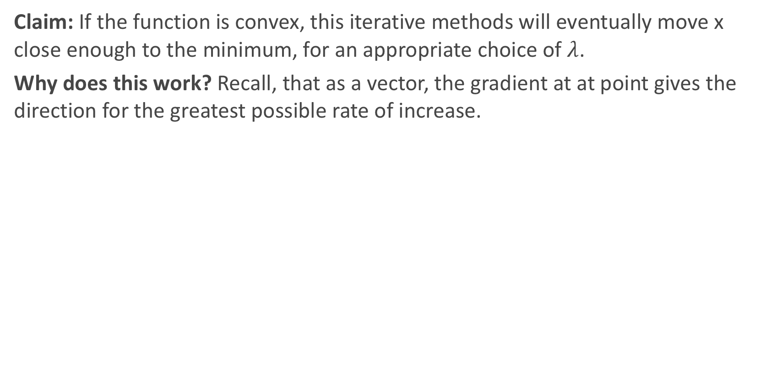
Why Does Gradient Descent Work?
Claim: If the function is convex, this iterative methods will eventually move x close enough to the minimum, for an appropriate choice of $λ$.
Why does this work? Recall, that as a vector, the gradient at at point gives the direction for the greatest possible rate of increase.

Slide 19
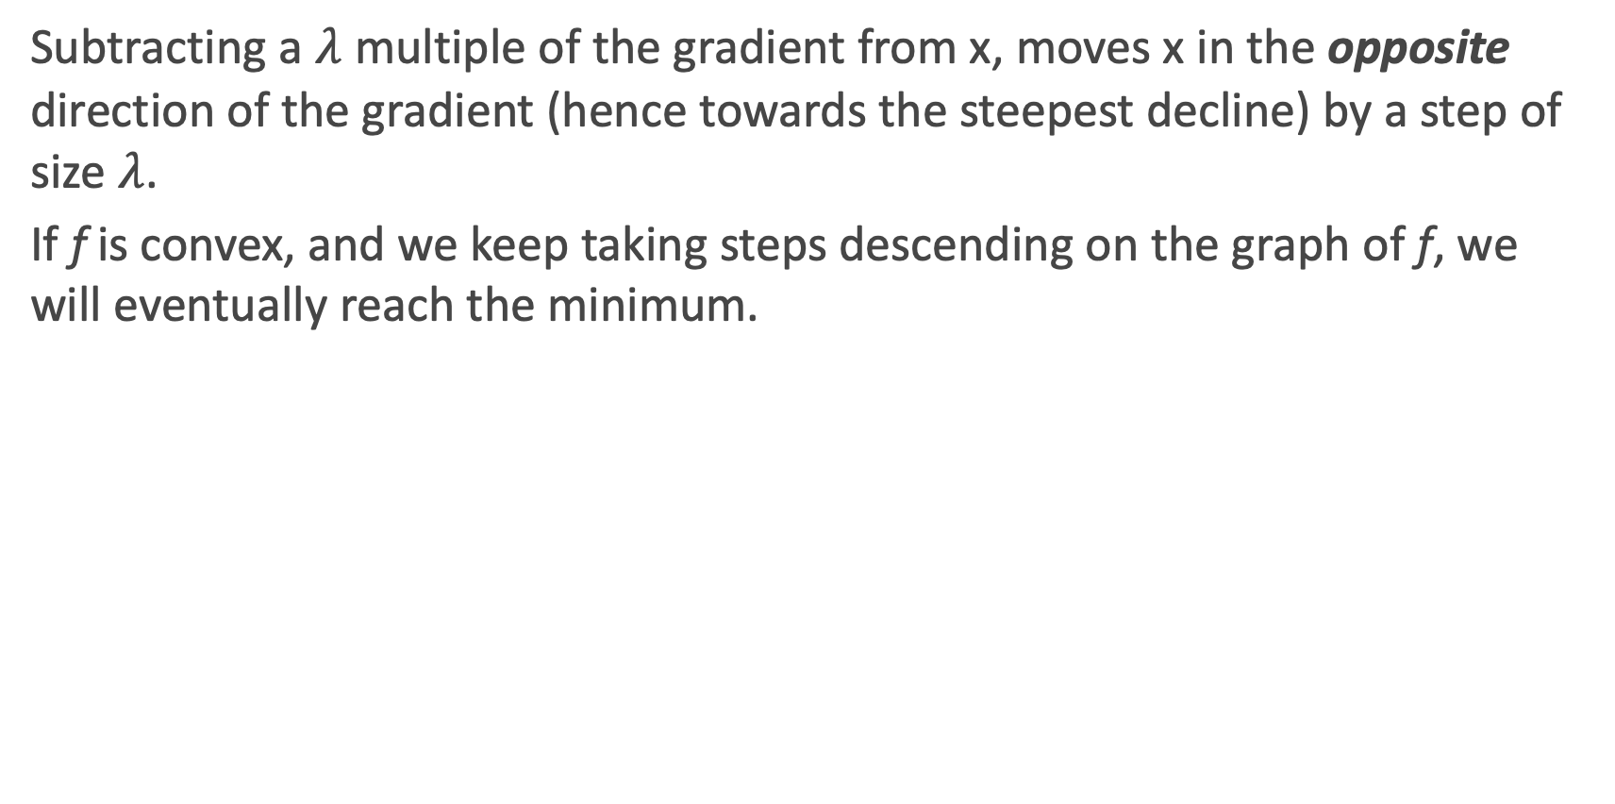
Why Does Gradient Descent Work?
Subtracting a $λ$ multiple of the gradient from x, moves x in the opposite direction of the gradient (hence towards the steepest decline) by a step of size $λ$.
If f is convex, and we keep taking steps descending on the graph of f, we will eventually reach the minimum.

Slide 20
Gradient Boosting as Gradient Descent
Often in regression, our objective is to minimize the MSE
Treating this as an optimization problem, we can try to directly minimize the MSE with respect to the predictions
The update step for gradient descent would look like

Slide 21
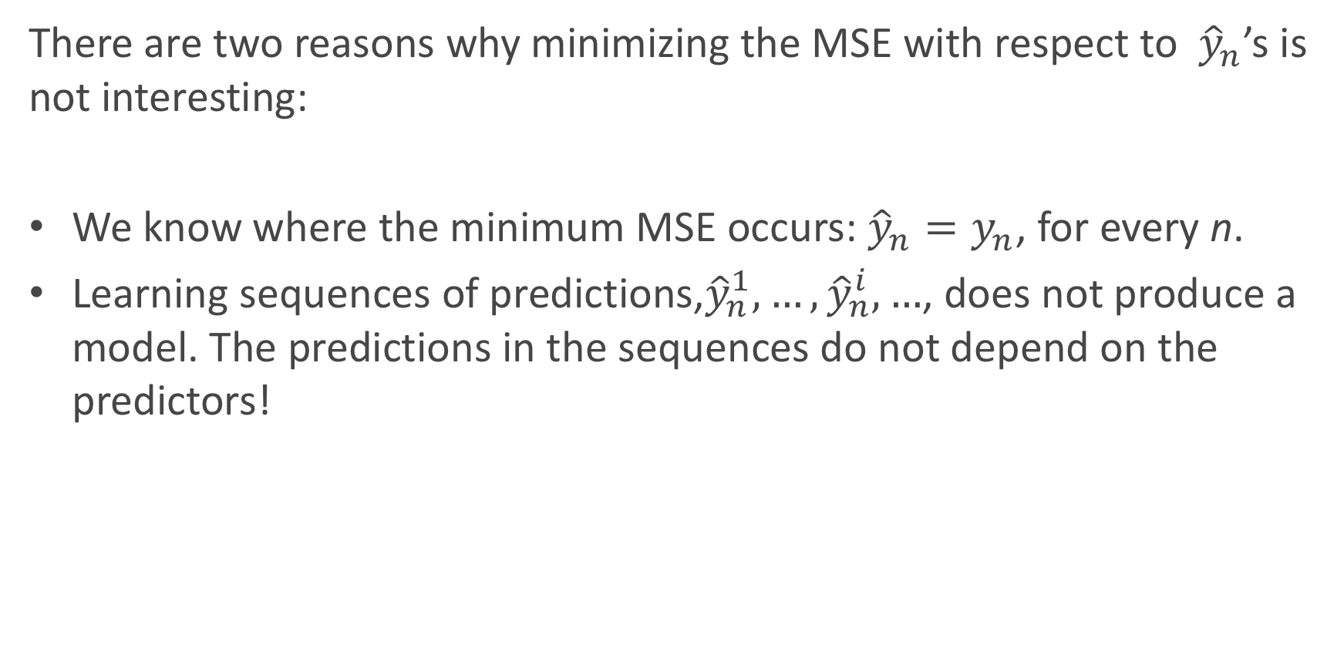
Gradient Boosting as Gradient Descent (cont.)
There are two reasons why minimizing the MSE with respect to ${\hat{y}}_{n}$’s is not interesting:
We know where the minimum MSE occurs: ${\hat{y}}_{n}=y_{n}$, for every n.
Learning sequences of predictions,${\hat{y}}_{n}^{1},…,{\hat{y}}_{n}^{i},…$, does not produce a model. The predictions in the sequences do not depend on the predictors!

Slide 22
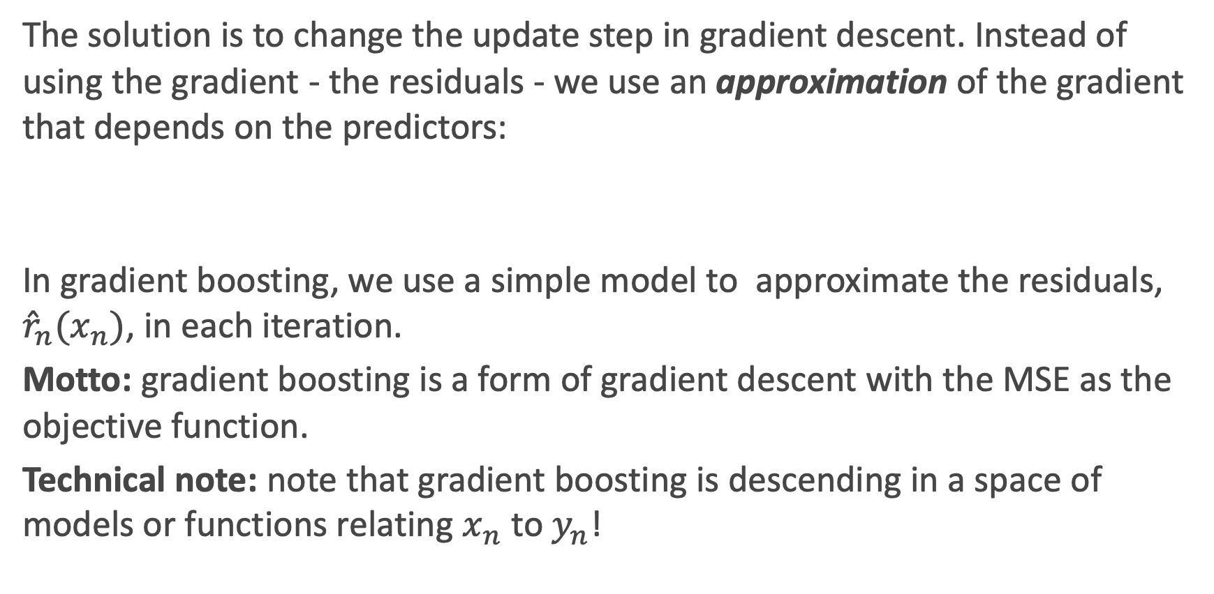
Gradient Boosting as Gradient Descent (cont.)
The solution is to change the update step in gradient descent. Instead of using the gradient - the residuals - we use an approximation of the gradient that depends on the predictors:
In gradient boosting, we use a simple model to approximate the residuals, ${{\hat{r}}_{n}(x}_{n})$, in each iteration.
Motto: gradient boosting is a form of gradient descent with the MSE as the objective function.
Technical note: note that gradient boosting is descending in a space of models or functions relating $x_{n}$ to $y_{n}$!

Slide 23
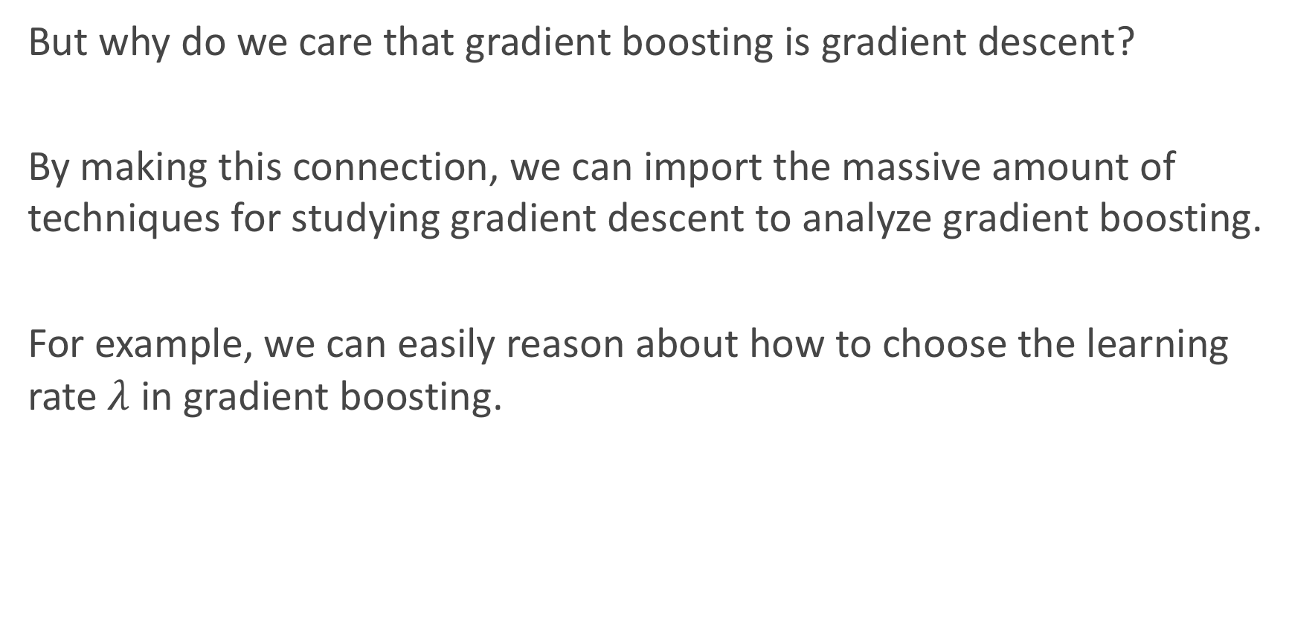
Gradient Boosting as Gradient Descent (cont.)
But why do we care that gradient boosting is gradient descent?
By making this connection, we can import the massive amount of techniques for studying gradient descent to analyze gradient boosting.
For example, we can easily reason about how to choose the learning rate $λ$ in gradient boosting.

Slide 24
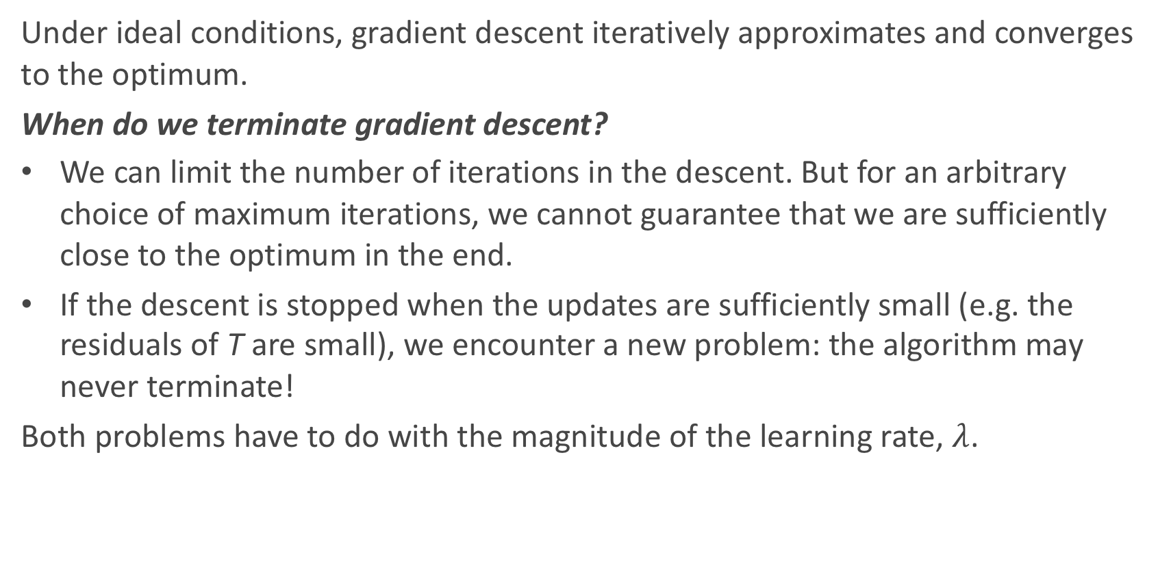
Choosing a Learning Rate
Under ideal conditions, gradient descent iteratively approximates and converges to the optimum.
When do we terminate gradient descent?
We can limit the number of iterations in the descent. But for an arbitrary choice of maximum iterations, we cannot guarantee that we are sufficiently close to the optimum in the end.
If the descent is stopped when the updates are sufficiently small (e.g. the residuals of T are small), we encounter a new problem: the algorithm may never terminate!
Both problems have to do with the magnitude of the learning rate, $λ$.

Slide 25
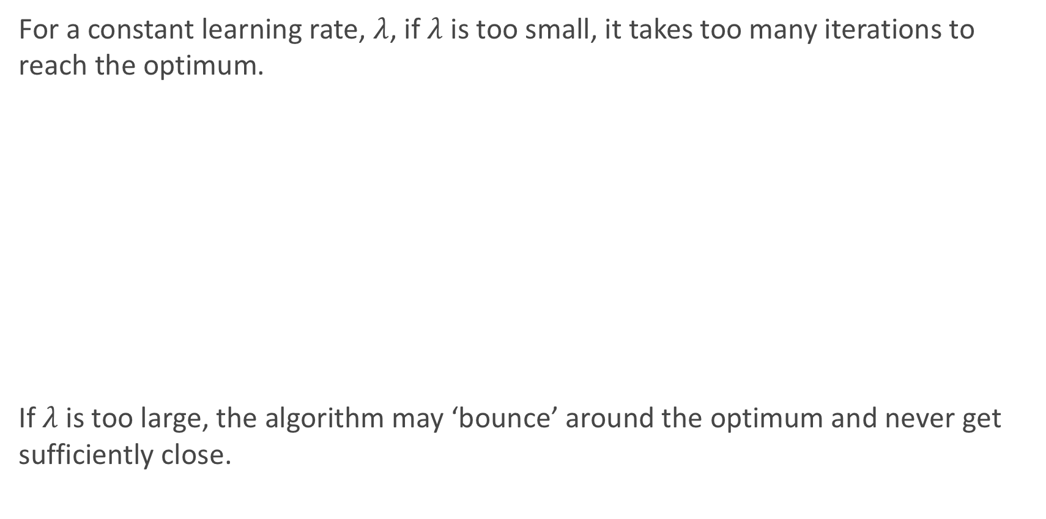
Choosing a Learning Rate
For a constant learning rate, $λ$, if $λ$ is too small, it takes too many iterations to reach the optimum.
If $λ$ is too large, the algorithm may ‘bounce’ around the optimum and never get sufficiently close.

Slide 26
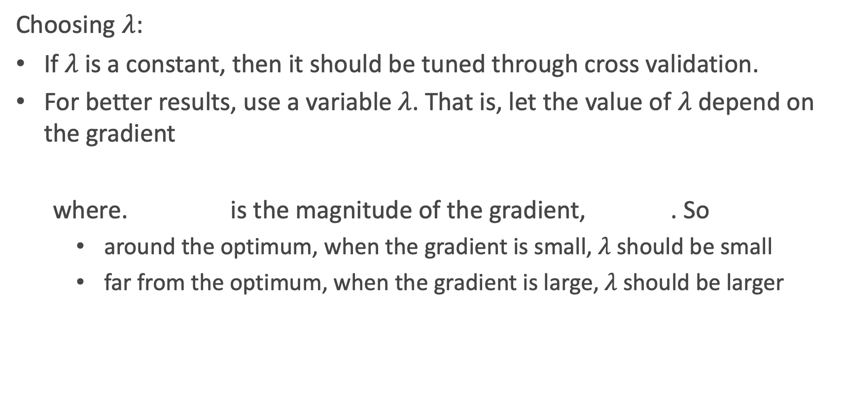
Choosing a Learning Rate
Choosing $λ$:
If $λ$ is a constant, then it should be tuned through cross validation.
For better results, use a variable $λ$. That is, let the value of $λ$ depend on the gradient
where. is the magnitude of the gradient, . So
around the optimum, when the gradient is small, $λ$ should be small
far from the optimum, when the gradient is large, $λ$ should be larger

Slide 27
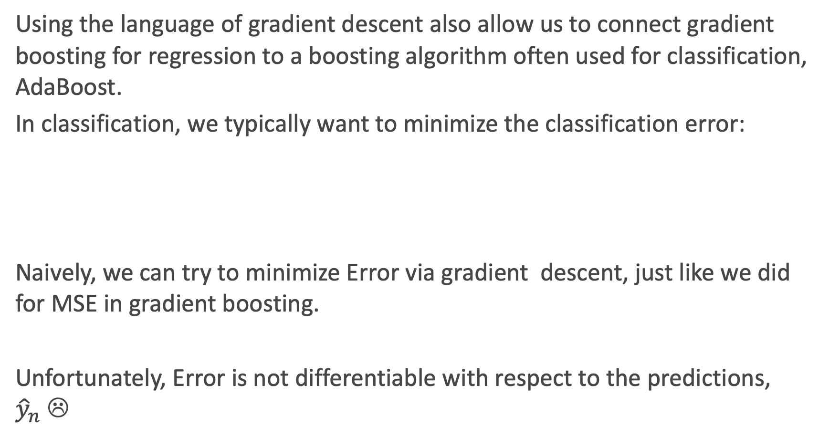
Motivation for AdaBoost
Using the language of gradient descent also allow us to connect gradient boosting for regression to a boosting algorithm often used for classification, AdaBoost.
In classification, we typically want to minimize the classification error:
Naively, we can try to minimize Error via gradient descent, just like we did for MSE in gradient boosting.
Unfortunately, Error is not differentiable with respect to the predictions, ${\hat{y}}_{n}$☹

Slide 28
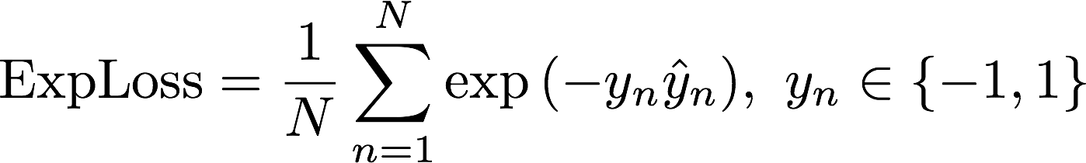
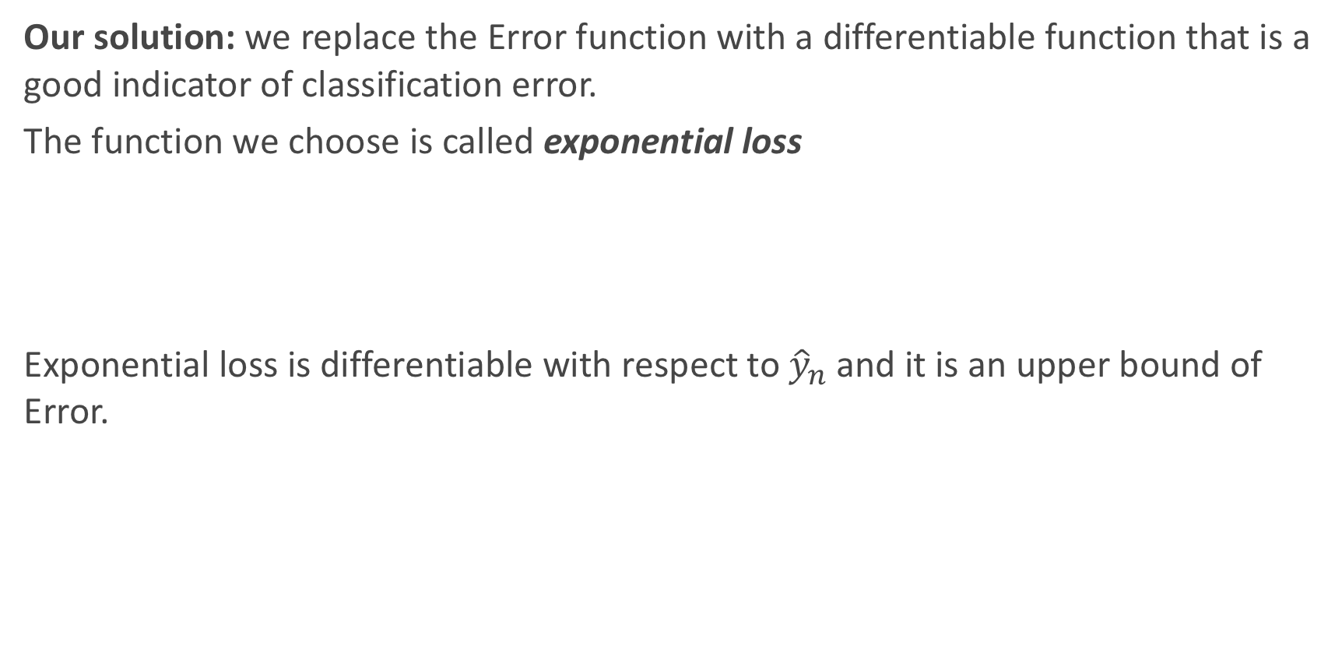
Motivation for AdaBoost (cont.)
Our solution: we replace the Error function with a differentiable function that is a good indicator of classification error.
The function we choose is called exponential loss
Exponential loss is differentiable with respect to ${\hat{y}}_{n}$and it is an upper bound of Error.

Slide 29
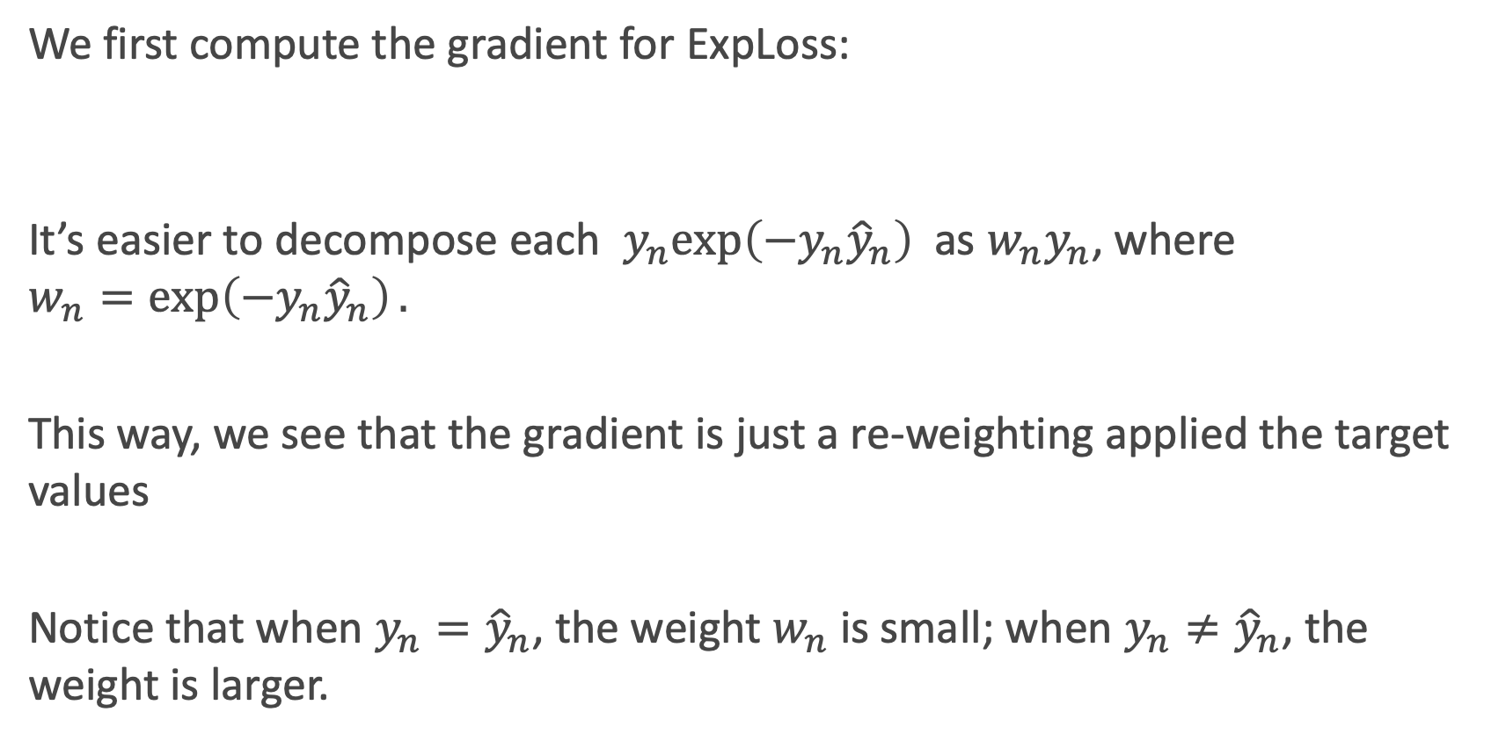
Gradient Descent with Exponential Loss
We first compute the gradient for ExpLoss:
It’s easier to decompose each $y_{n}exp\left(−y_{n}{\hat{y}}_{n}\right)$as ${w_{n}y}_{n}$, where $$w_{n}=\exp\left(−y_{n}{\hat{y}}_{n}\right).$$
This way, we see that the gradient is just a re-weighting applied the target values
Notice that when $y_{n}={\hat{y}}_{n}$, the weight $w_{n}$ is small; when $y_{n}≠{\hat{y}}_{n}$, the weight is larger.

Slide 30
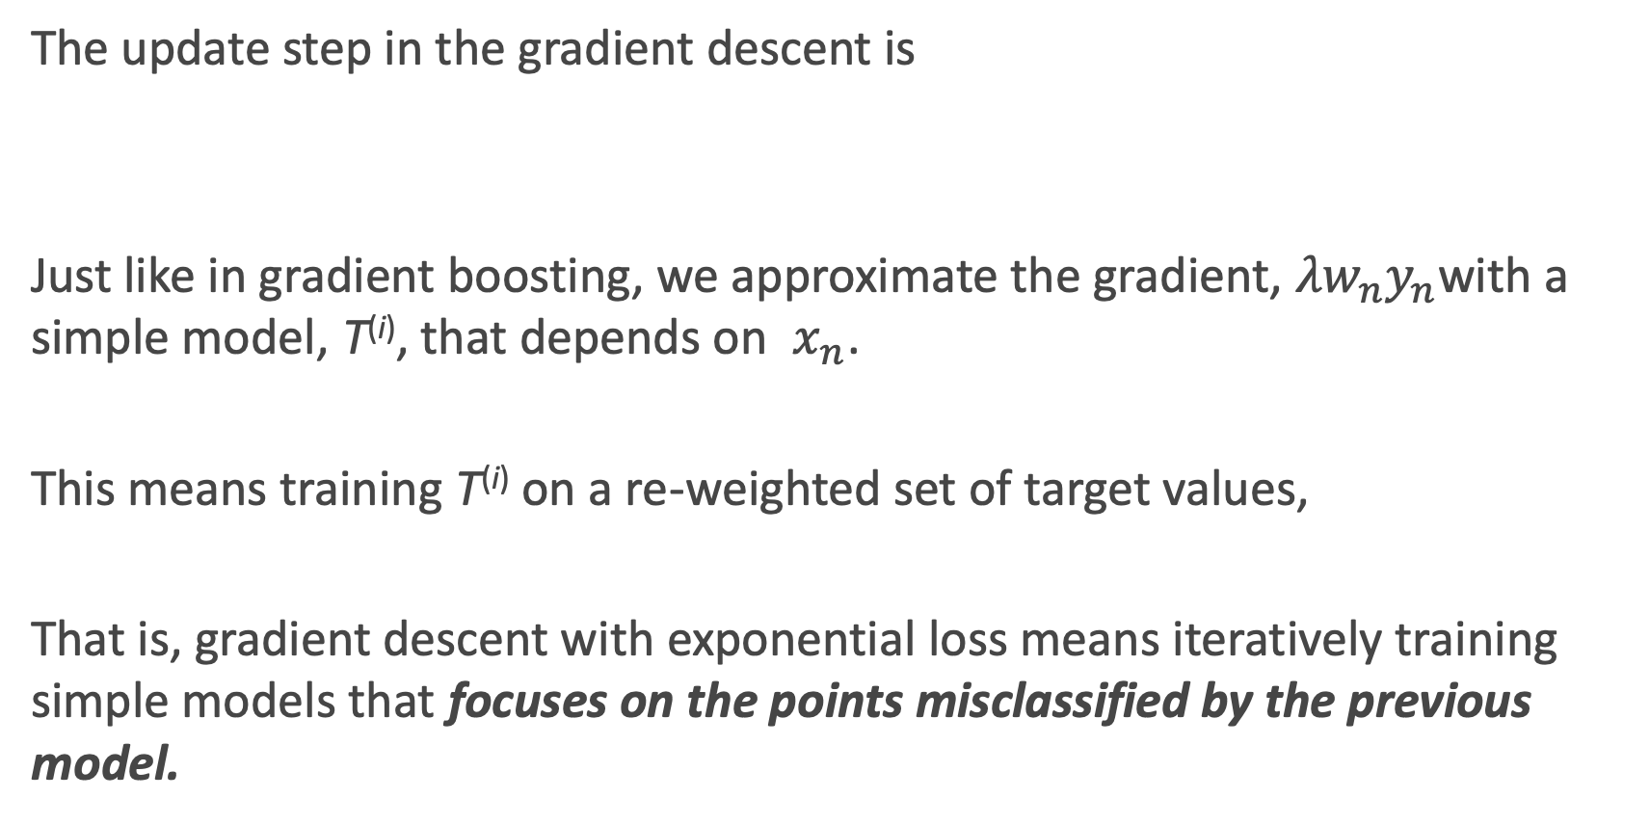
Gradient Descent with Exponential Loss
The update step in the gradient descent is
Just like in gradient boosting, we approximate the gradient, ${{λw}_{n}y}_{n}$with a simple model, T^{(i)}, that depends on $x_{n}$.
This means training T^{(i)} on a re-weighted set of target values,
That is, gradient descent with exponential loss means iteratively training simple models that focuses on the points misclassified by the previous model.

Slide 31
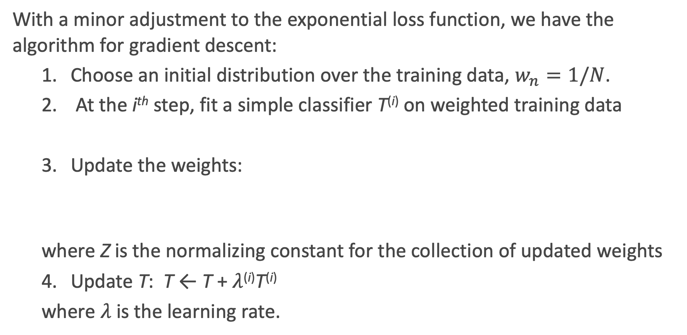
AdaBoost
With a minor adjustment to the exponential loss function, we have the algorithm for gradient descent:
1. Choose an initial distribution over the training data, $w_{n}=1/N$.
2. At the i^{th} step, fit a simple classifier T^{(i)} on weighted training data
3. Update the weights:
where Z is the normalizing constant for the collection of updated weights
4. Update T: T ← T + $λ$^{(i)}T^{(i)}
where $λ$ is the learning rate.

Slide 32
Choosing the Learning Rage
Unlike in the case of gradient boosting for regression, we can analytically solve for the optimal learning rate for AdaBoost, by optimizing:
Doing so, we get that

Slide 33
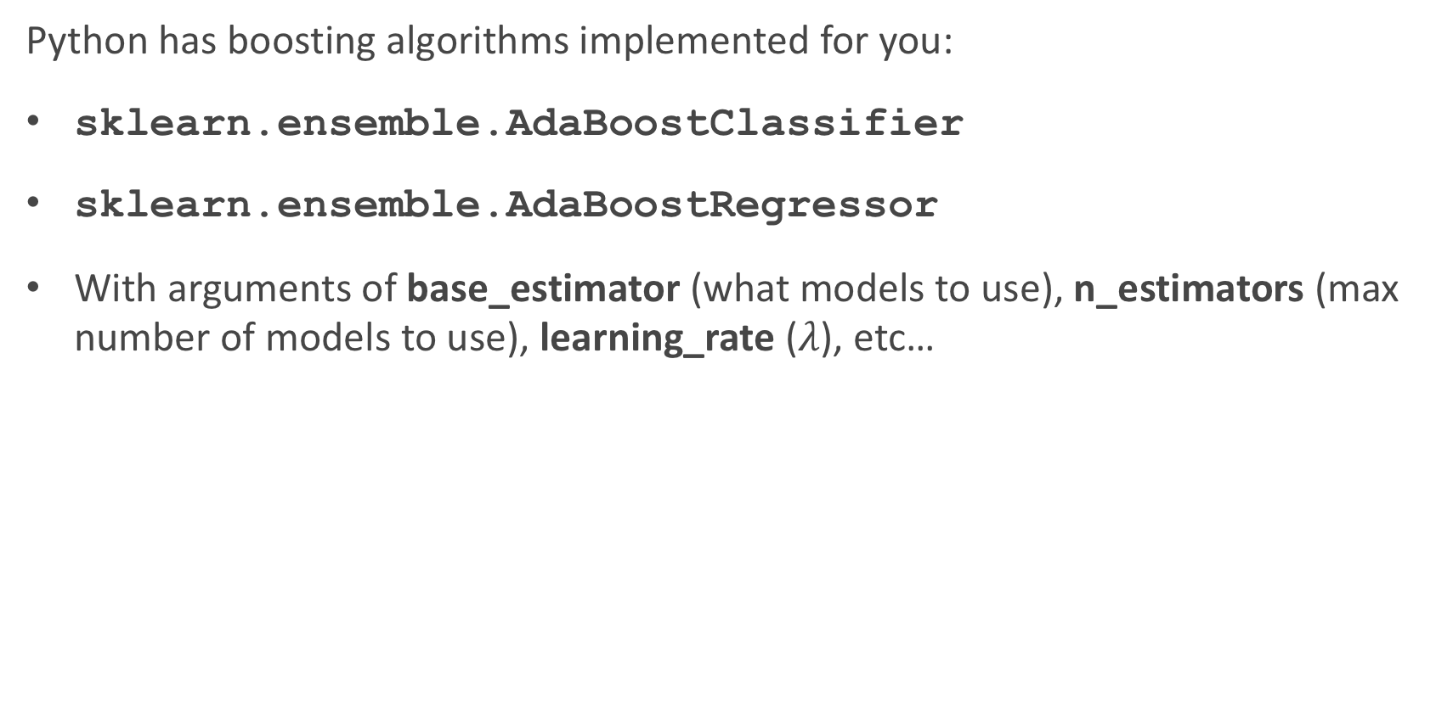
Boosting in sklearn
Python has boosting algorithms implemented for you:
sklearn.ensemble.AdaBoostClassifier
sklearn.ensemble.AdaBoostRegressor
With arguments of base_estimator (what models to use), n_estimators (max number of models to use), learning_rate ($λ$), etc…

Slide 34
Stacking

Slide 35
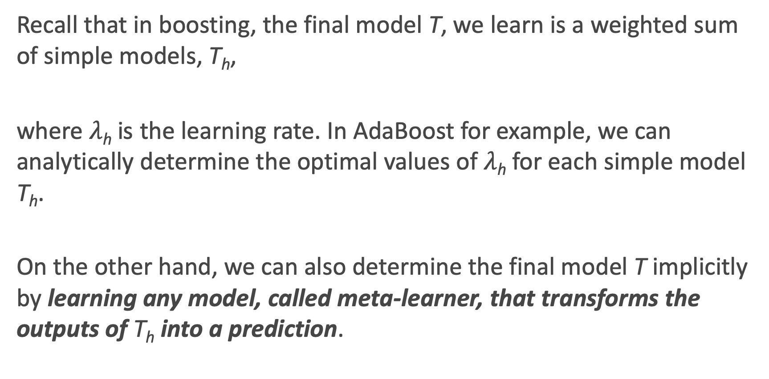
Motivation for Stacking
Recall that in boosting, the final model T, we learn is a weighted sum of simple models, T_{h},
where $λ$_{h} is the learning rate. In AdaBoost for example, we can analytically determine the optimal values of $λ$_{h} for each simple model T_{h}.
On the other hand, we can also determine the final model T implicitly by learning any model, called meta-learner, that transforms the outputs of T_{h} into a prediction.

Slide 36
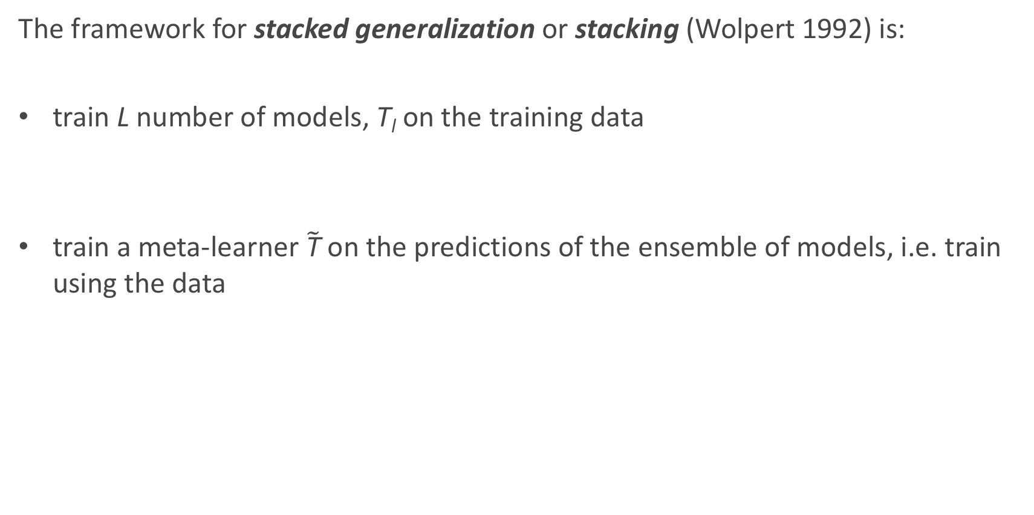
Stacked Generalization
The framework for stacked generalization or stacking (Wolpert 1992) is:
train L number of models, T_{l} on the training data
train a meta-learner $\tilde{\text{T}}$ on the predictions of the ensemble of models, i.e. train using the data

Slide 37
Stacking: an Illustration

Slide 38
Stacking: General Guidelines
The flexibility of stacking makes it widely applicable but difficult to analyze theoretically. Some general rules have been found through empirical studies:
models in the ensemble should be diverse, i.e. their errors should not be correlated
for binary classification, each model in the ensemble should have error rate < 1/2
if models in the ensemble outputs probabilities, it’s better to train the meta-learner on probabilities rather than predictions
apply regularization to the meta-learner to avoid overfitting

Slide 39
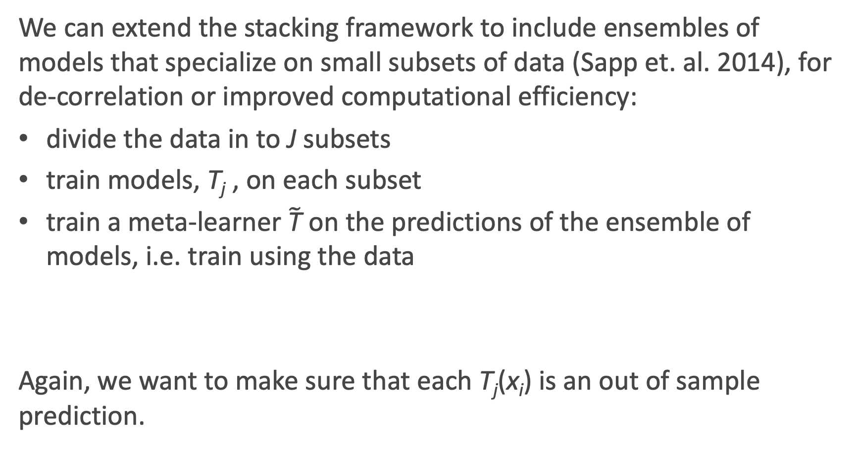
Stacking: Subsemble Approach
We can extend the stacking framework to include ensembles of models that specialize on small subsets of data (Sapp et. al. 2014), for de-correlation or improved computational efficiency:
divide the data in to J subsets
train models, T_{j} , on each subset
train a meta-learner $\tilde{\text{T}}$ on the predictions of the ensemble of models, i.e. train using the data
Again, we want to make sure that each T_{j}(x_{i}) is an out of sample prediction.

Slide 40
Stacking in sklearn
Unfortunately, Python does not have stacking algorithms implemented for you ☹
So how can we do it?
We can set it up by ‘manually’ fitting several base models, take the outputs of those models, and fitting the meta model on the outputs of those base models.
It’s a model on models!

Slide 41
Artificial Neural Networks (ANN)

Slide 42
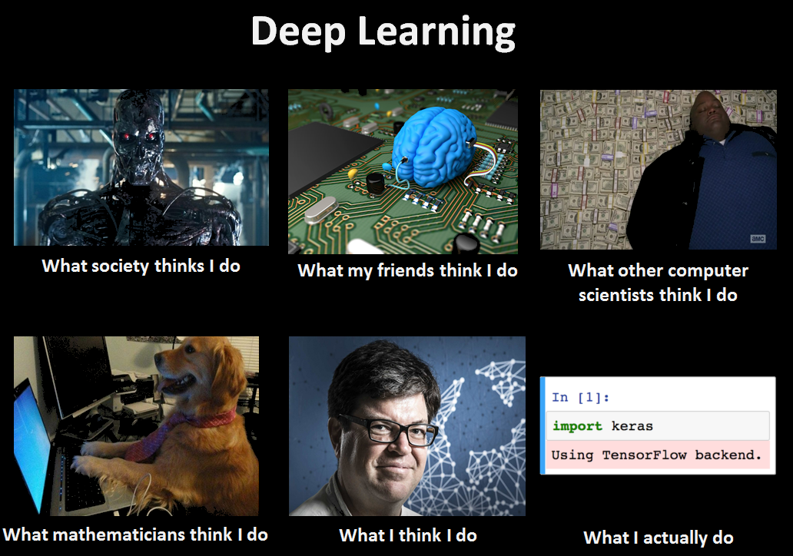

Slide 43


Today’s news

Slide 44
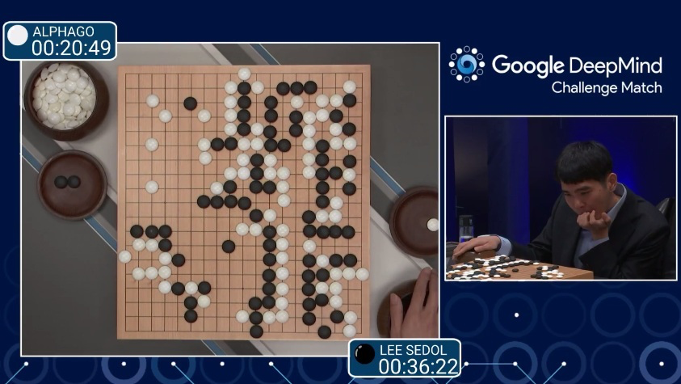
AlphaGo (2015)
First program to beat a professional Go player
Notes:
https://www.youtube.com/watch?v=PQCrX1sQSzY

Slide 45
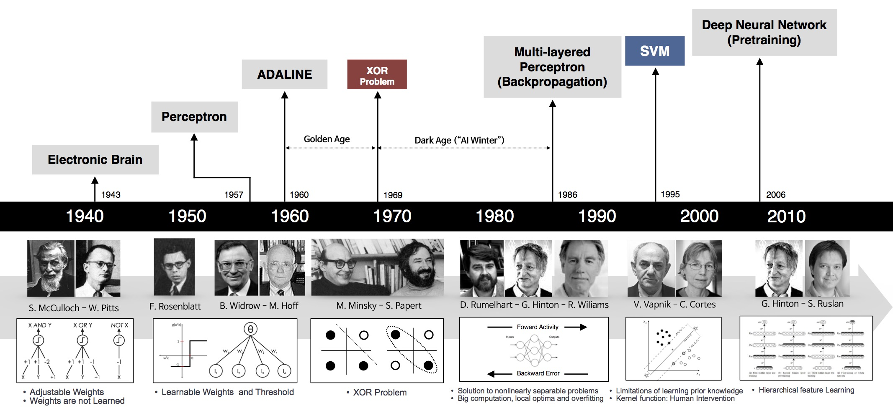
Historical Trends
beamandrew.github.io/

Slide 46
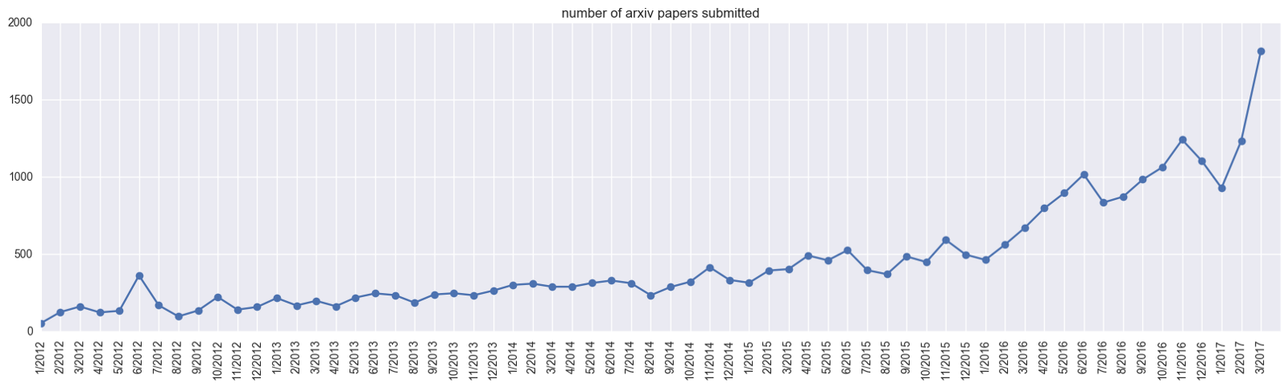
Historical Trends
ArXiv papers on deep learning: 2012-2017
ArXiv papers on deep learning: 2012-2017

Slide 47
Anatomy of artificial neural network (ANN)
input layer (predictors)
output layer (response)
hidden layer 1
hidden layer 2

Slide 48
Translating Logistic Regression into NN language

Slide 49
Regression and Classification
Methods that are centered around modeling and prediction of a quantitative response variable (ex, number of taxi pickups, number of bike rentals, etc) are called regressions (and Ridge, LASSO, etc).
When the response variable is categorical, then the problem is no longer called a regression problem but is instead labeled as a classification problem.
The goal is to attempt to classify each observation into a category (aka, class or cluster) defined by Y, based on a set of predictor variables X.

Slide 50
Typical Classification Examples
The motivating examples for this lecture(s), homework, and labs are based on classification. Classification problems are common in these domains:
Trying to determine where to set the cut-off for some diagnostic test (pregnancy tests, prostate or breast cancer screening tests, etc...)
Trying to determine if cancer has gone into remission based on treatment and various other indicators
Trying to classify patients into types or classes of disease based on various genomic markers

Slide 51
Heart Data
response variable Y
is Yes/No
Age | Sex | ChestPain | RestBP | Chol | Fbs | RestECG | MaxHR | ExAng | Oldpeak | Slope | Ca | Thal | AHD
63 | 1 | typical | 145 | 233 | 1 | 2 | 150 | 0 | 2.3 | 3 | 0.0 | fixed | No
67 | 1 | asymptomatic | 160 | 286 | 0 | 2 | 108 | 1 | 1.5 | 2 | 3.0 | normal | Yes
67 | 1 | asymptomatic | 120 | 229 | 0 | 2 | 129 | 1 | 2.6 | 2 | 2.0 | reversable | Yes
37 | 1 | nonanginal | 130 | 250 | 0 | 0 | 187 | 0 | 3.5 | 3 | 0.0 | normal | No
41 | 0 | nontypical | 130 | 204 | 0 | 2 | 172 | 0 | 1.4 | 1 | 0.0 | normal | No

Slide 52
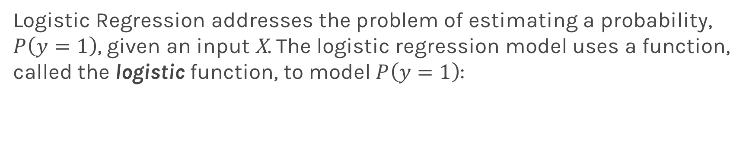
Logistic Regression
Logistic Regression addresses the problem of estimating a probability, $P\left(y=1\right)$, given an input X. The logistic regression model uses a function, called the logistic function, to model $P\left(y=1\right)$:

Slide 53
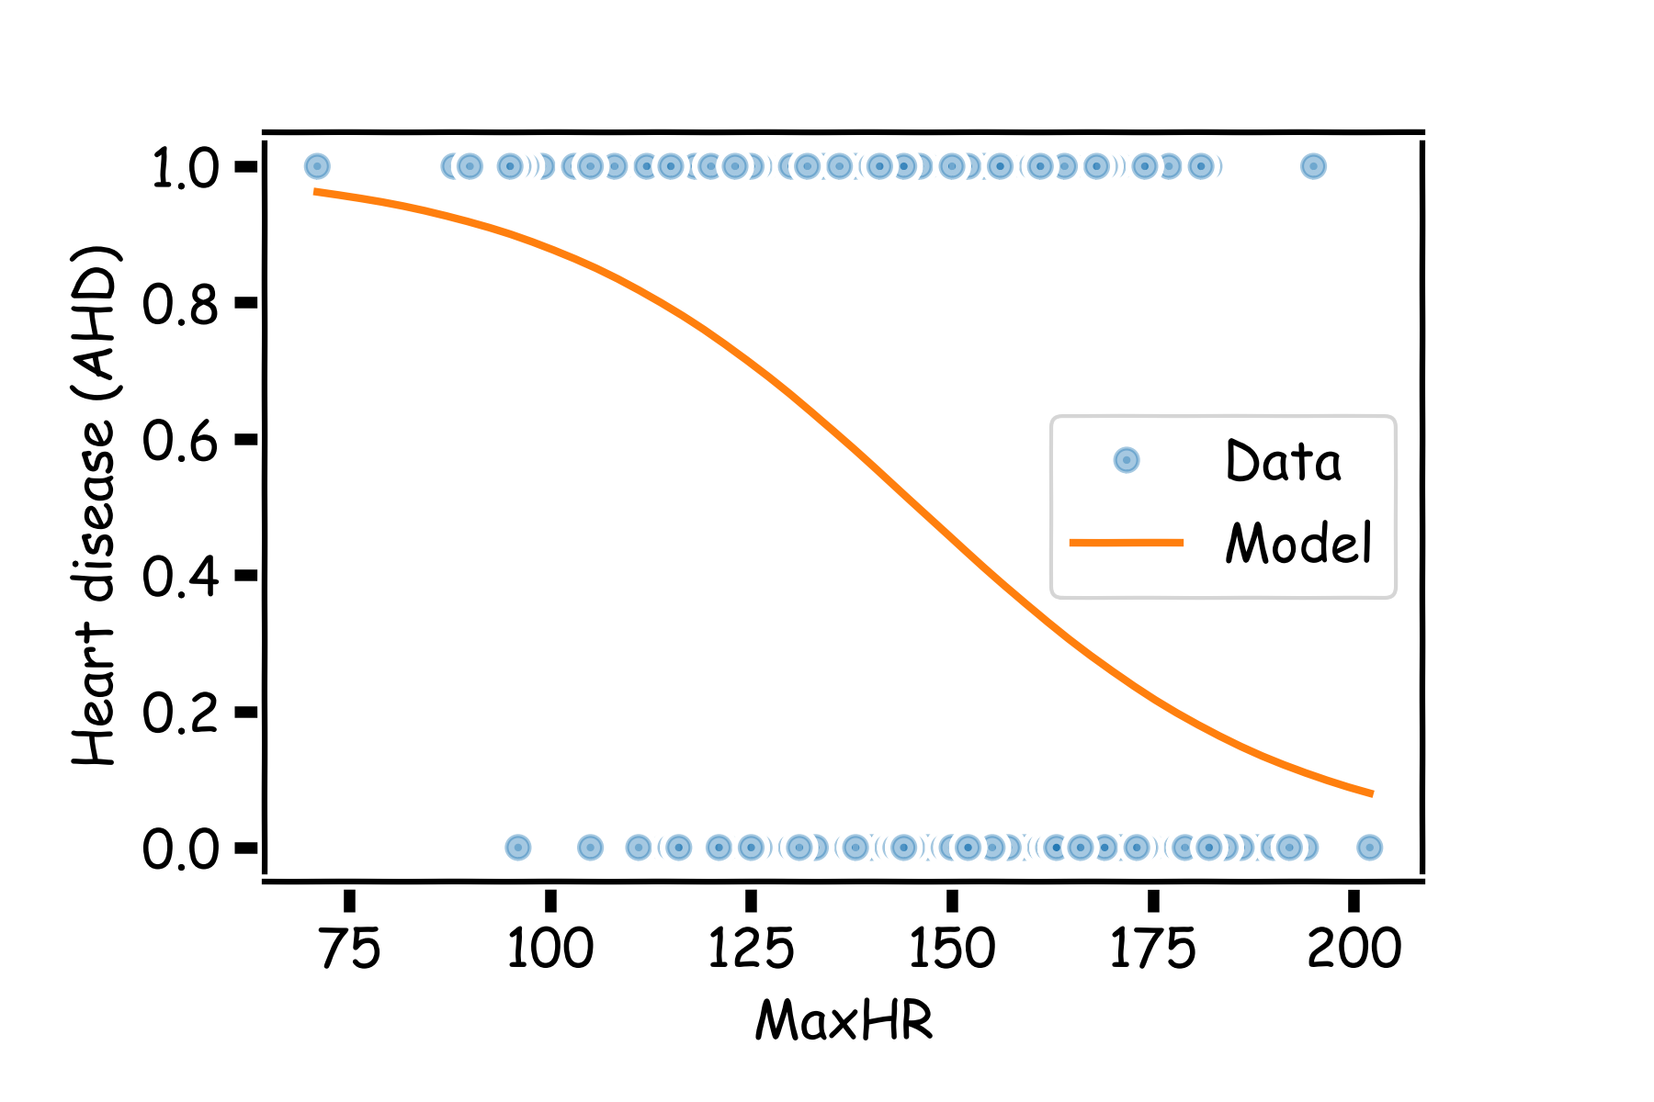
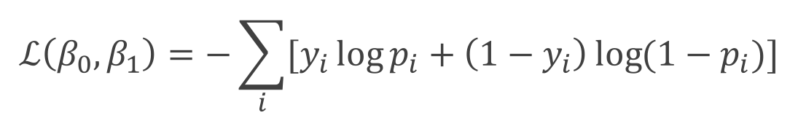
Estimating the coefficients for Logistic Regression
Find the coefficients that minimize the loss function
$$ℒ\left(β_{0}, β_{1}\right)=−\sum_{i}{[y_{i}\log{p_{i}+\left(1−y_{i}\right)\log{(1−p_{i})]}}}$$

Slide 54
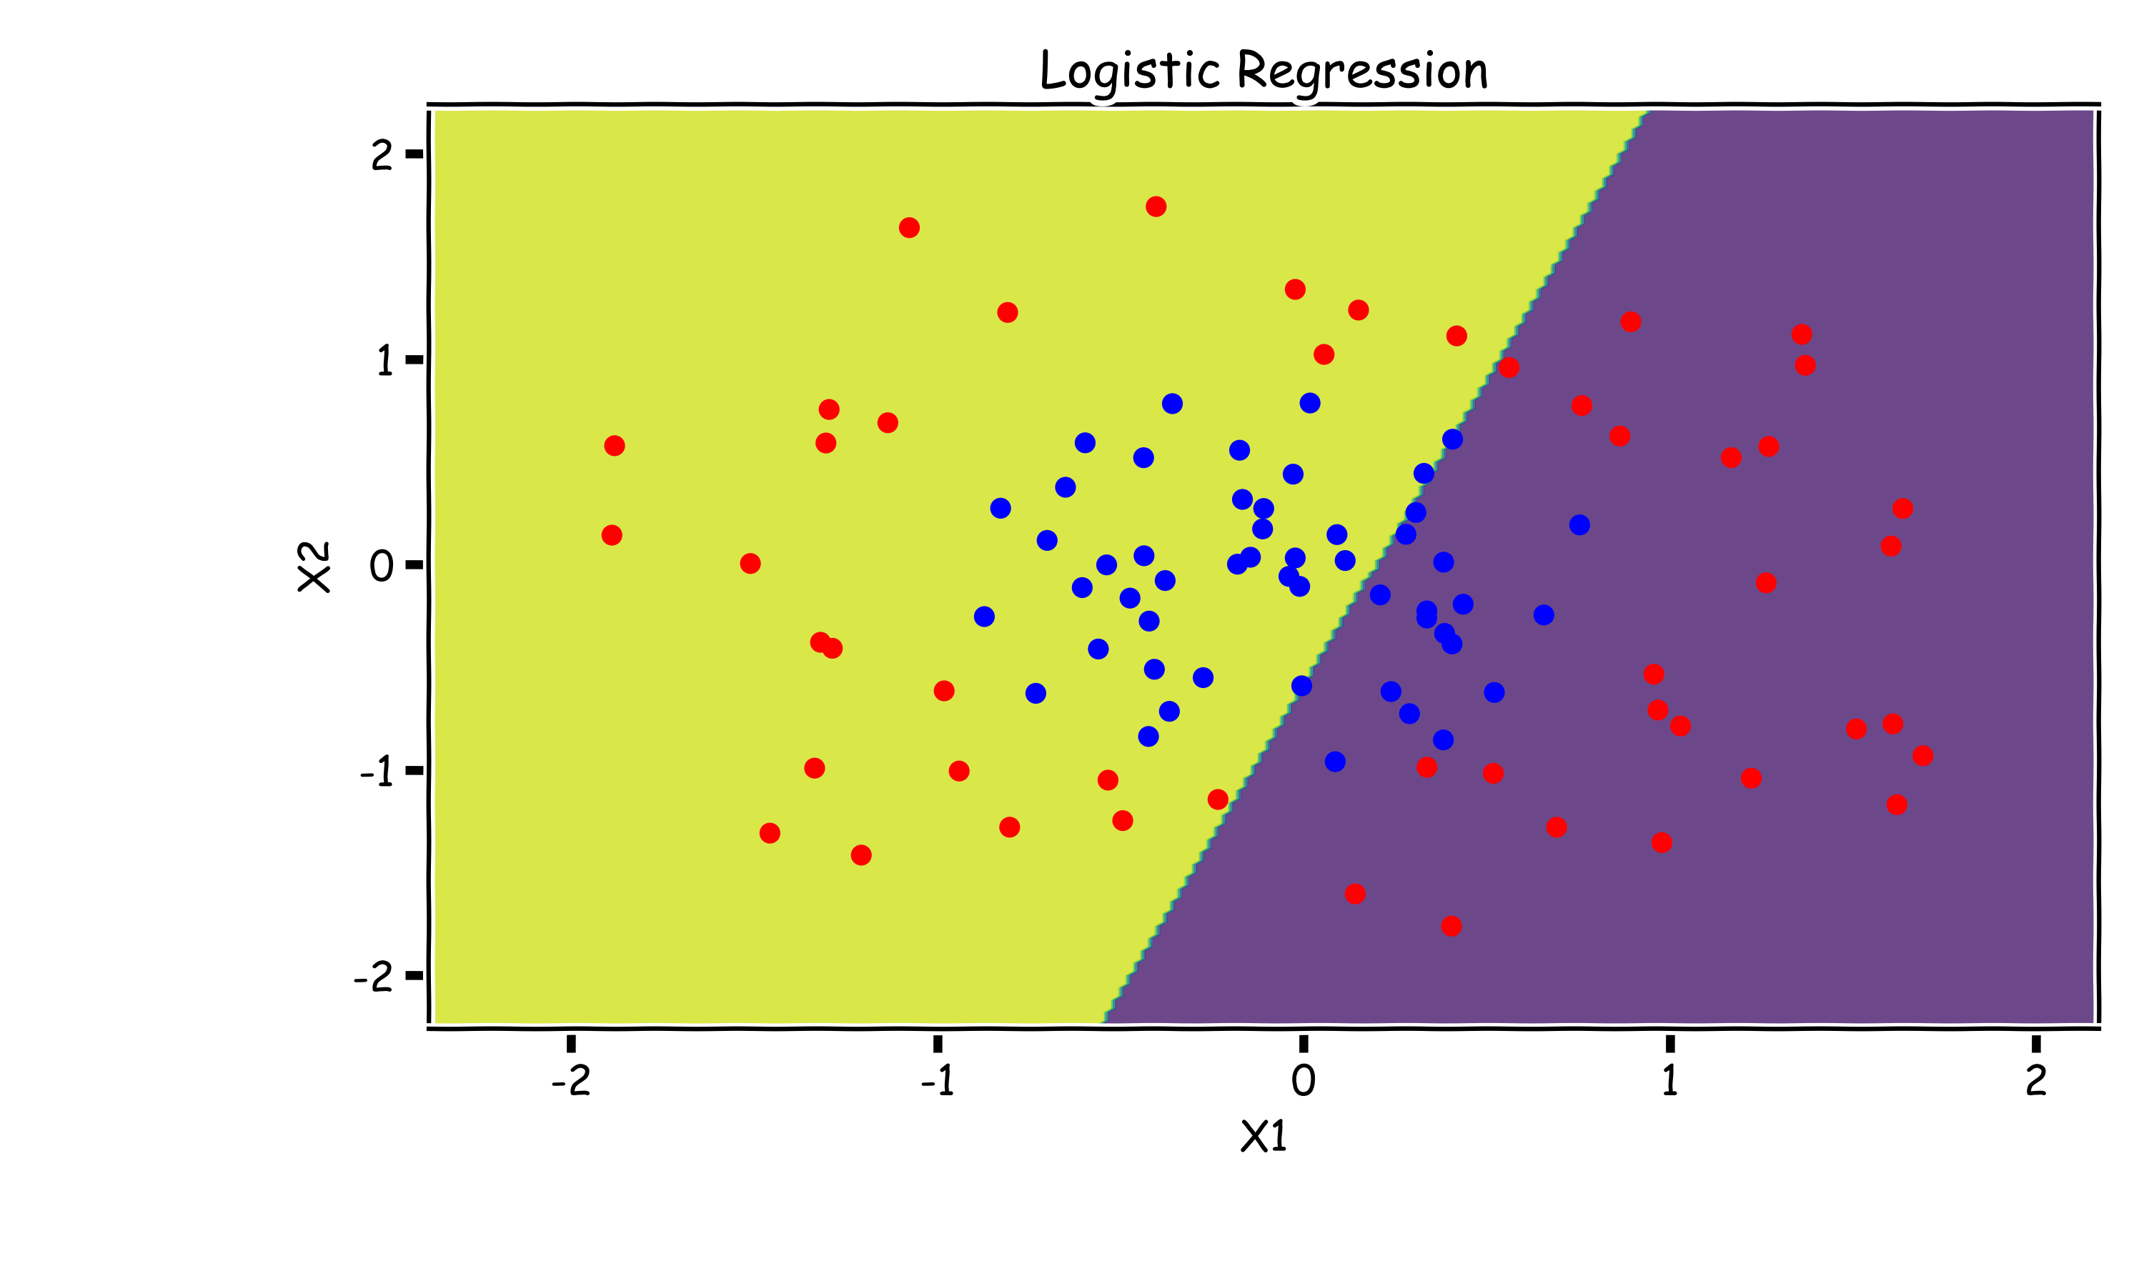
Need for Non-Linearity
Without augmenting the features (i.e. without adding X₁² or X₂² non-linear features), Logistic Regression is incapable of modeling the correct decision boundary.

Slide 55
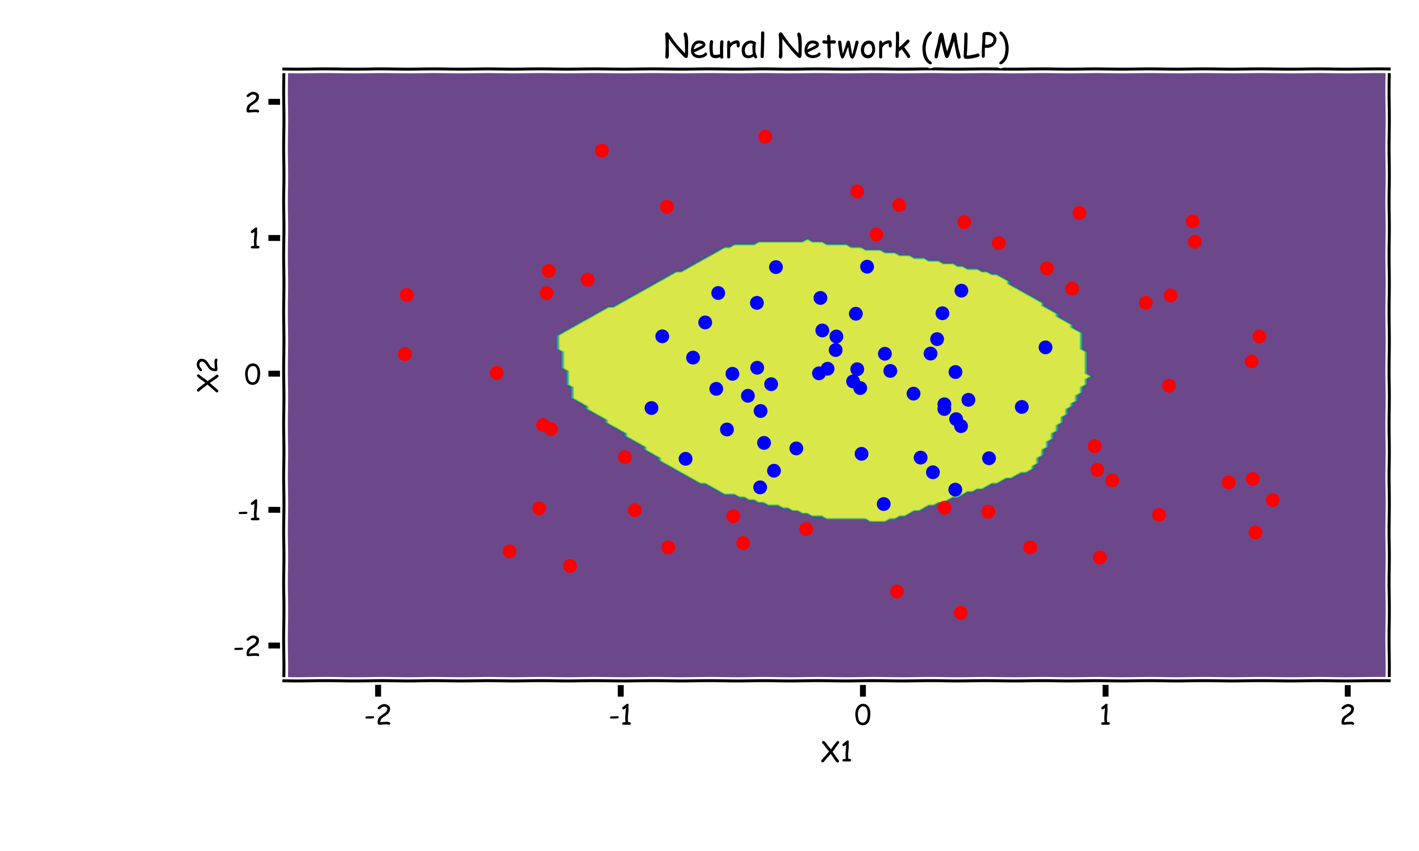
Neural Networks to The Rescue
A neural network is a powerful non-linear model that can easily model the non-linear decision boundary correctly.

Slide 56
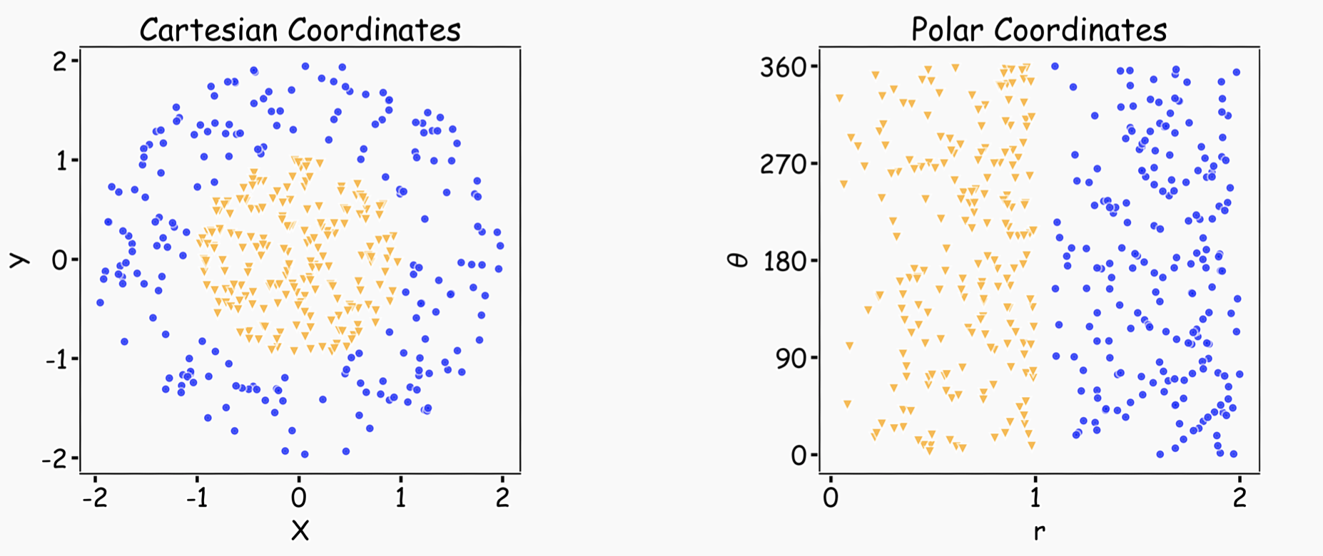
Representation Matters
Neural networks can learn useful representations for the problem. This is another reason why they can be so powerful!

Slide 57
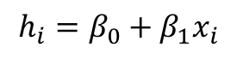
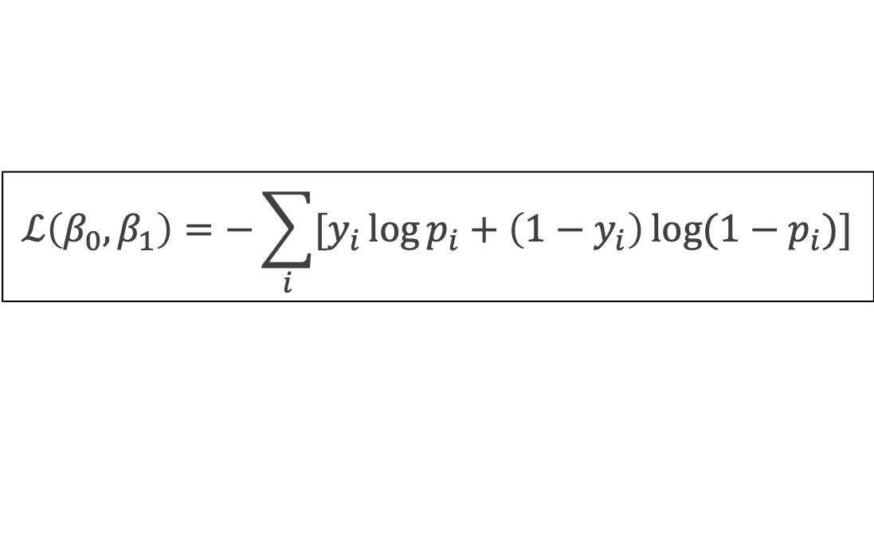
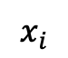
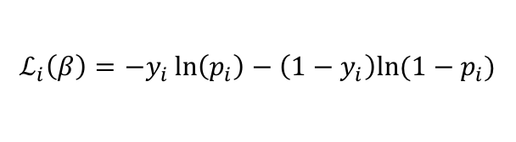
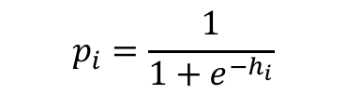
Logistic Regression Revisited (with new terminology)
$$ℒ\left(β_{0}, β_{1}\right)=−\sum_{i}{[y_{i}\log{p_{i}+\left(1−y_{i}\right)\log{(1−p_{i})]}}}$$
Affine
Activation
Loss Fun
$$p_{i}=\frac{1}{1+e^{−h_{i}}}$$
$$x_{i}$$
$$h_{i}=β_{0}+β_{1}x_{i}$$
$$ℒ_{i}\left(β\right)=−y_{i}\ln\left(p_{i}\right)−\left(1−y_{i}\right)ln⁡(1−p_{i})$$

Slide 58
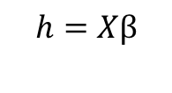
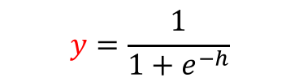
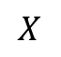
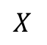
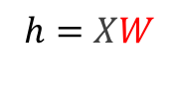


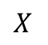
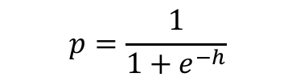

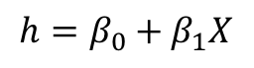
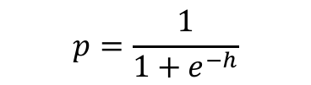
Build our first ANN
Affine
Activation
Loss Fun
$$ℒ(β)=\sum_{i}^{n}{ℒ_{i}\left(β\right)}$$
$$p=\frac{1}{1+e^{−h}}$$
$$X$$
$$h=β_{0}+β_{1}X$$
Affine
Activation
Loss Fun
$$ℒ(β)=\sum_{i}^{n}{ℒ_{i}\left(β\right)}$$
$$p=\frac{1}{1+e^{−h}}$$
$$X$$
$$h=Xβ$$
Affine
Activation
Loss Fun
$$ℒ(W)=\sum_{i}^{n}{ℒ_{i}\left(W\right)}$$
$$y=\frac{1}{1+e^{−h}}$$
$$X$$
$$h=XW$$

Slide 59



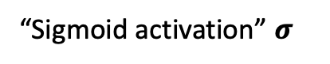



Build our first ANN
Affine
Activation
Loss Fun
$$ℒ(W)=\sum_{i}^{n}{ℒ_{i}\left(W\right)}$$
$$p=\frac{1}{1+e^{−h}}$$
$$X$$
$$h=XW$$
“Sigmoid activation” $σ$
$$X$$
$σ$(XW)
$$Y$$
Single Neuron Network
Very similar to Perceptron

Slide 60

Example Using Heart Data
Slightly modified data to illustrate concepts.

Slide 61




Example Using Heart Data
Choose W such as
$$X$$
$σ$(XW)
$$Y$$

Slide 62


Example Using Heart Data
Choose W such as
$$X$$
$σ$(XW)
$$Y$$

Slide 63







Example
$$X$$
$σ$(XW₁)
$$Y$$
$$X$$
$σ$(XW₂)
$$Y′$$

Slide 64










Let’s combine them!
$σ$(XW₁)
$$Y$$
$$h_{1}$$
$$q= W_{31}h_{1}+{W_{32}h}_{2}+W_{30}$$
Affine (h1 + h2)
$$X$$
$$Y′$$
$$h_{2}$$
Not a probability!
$σ$(XW₂)

Slide 65




What’s the output?
$$q= W_{31}h_{1}+{W_{32}h}_{2}+W_{30}$$
$$p=\frac{1}{1+e^{−q}}$$
$σ$(XW₁)
$$Y$$
$$h_{1}$$
$$X$$
$σ$(hW₃)
$σ$(XW₂)
$$Y′$$
$$h_{2}$$
Passing through sigmoid yields probability
$$L=−y ln\left(p\right)−\left(1−y\right)ln(1−p)$$
Need to learn W₁ (2 parameters), W₂ (2 parameters), and W₃ (3 parameters).

Slide 66


Combining neurons allows us to model interesting functions

Slide 67

Different ‘weights’ change the shape and position

Slide 68


Adding layers allows us to model increasingly complex functions

Slide 69


Neural networks can model any reasonable function

Slide 70
Summary (so far)
So far:
A single neuron can be a logistic regression unit. We will soon see other choices.
A neural network is a combination of logistic regression (or other types) units.
A neural network can approximate non-linear functions.
Next:
How many neurons?
What ”other choices”?
And beyond:
How do we estimate weights and biases?
Regularize Neural Networks.

Slide 71
Anatomy of a NN

Slide 72


Anatomy of artificial neural network (ANN)
neuron
node
input
output
Affine transformation
$$Y=f(h)$$
Activation
X
Y
h$=W^{T}X$
We will talk later about the choice of activation function. So far we have only talked about sigmoid as an activation function but there are other choices.

Slide 73









Anatomy of artificial neural network (ANN)
Input layer
hidden layer
output layer
$$z_{1}=W_{1}^{T}X=W_{11}X_{1}+W_{12}X_{2}+W_{10} \\ h_{1}=f(z_{1})$$
$$X_{1}$$
$$W_{1}$$
$$\hat{Y}$$
$$\hat{Y}=g(h_{1},h_{2})$$
$$J=ℒ(\hat{Y},Y)$$
Output function
Loss function
$$X_{2}$$
$$W_{2}$$
$$z_{2}=W_{2}^{T}X=W_{21}X_{1}+W_{22}X_{2}+W_{20}$$
$${ h}_{2}=f(z_{2})$$
We will talk later about the choice of the output layer and the loss function. So far we consider sigmoid as the output and log-bernouli.

Slide 74





Anatomy of artificial neural network (ANN)
Input layer
hidden layer 1
hidden layer 2
output layer
$$X_{1}$$
$$W_{11}$$
$$W_{21}$$
$$Y$$
$$X_{2}$$
$$W_{12}$$
$$W_{22}$$

Slide 75


Anatomy of artificial neural network (ANN)
Input layer
hidden layer 1
hidden layer n
output layer
$$X_{1}$$
$$W_{11}$$
…
$$W_{n1}$$
$$Y$$
$$X_{2}$$
$$W_{12}$$
…
$$W_{n2}$$
We will talk later about the choice of the number of layers.

Slide 76






Anatomy of artificial neural network (ANN)
Input layer
hidden layer 1, 3 nodes
hidden layer n
3 nodes
output layer
$$W_{n1}$$
$$W_{11}$$
$$X_{1}$$
$$W_{12}$$
…
$$W_{n2}$$
$$Y$$
$$X_{2}$$
$$W_{13}$$
$$W_{n3}$$

Slide 77


Anatomy of artificial neural network (ANN)
Input layer
hidden layer 1,
hidden layer n
output layer
m nodes
$$W_{n1}$$
$$W_{11}$$
$$X_{1}$$
m nodes
…
…
$$Y$$
$$X_{2}$$
$$W_{1m}$$
$$W_{nm}$$
We will talk later about the choice of the number of nodes.

Slide 78
Anatomy of artificial neural network (ANN)
Input layer
hidden layer 1,
hidden layer n
output layer
m nodes
$$W_{n1}$$
$$W_{11}$$
$$X_{1}$$
m nodes
Number of inputs d
…
…
$$Y$$
$$X_{2}$$
$$W_{1m}$$
$$W_{nm}$$
Number of inputs is specified by the data

Slide 79
Anatomy of artificial neural network (ANN)
input layer
output layer
hidden layer 1
hidden layer 2

Slide 80
Anatomy of artificial neural network (ANN)
input layer
output layer
hidden layer 1
hidden layer 2

Slide 81


Why layers? Representation
Representation matters!

Slide 82

Learning Multiple Components

Slide 83

Neural Networks
Hand-written digit recognition: MNIST data

Slide 84

Depth = Repeated Compositions

Slide 85

Beyond Linear Models
Linear models:
Can be fit efficiently (via convex optimization)
Limited model capacity
Alternative:
Where $φ$ is a non-linear transform

Slide 86

Traditional ML
Manually engineer $φ$
Domain specific, enormous human effort
Generic transform
Maps to a higher-dimensional space
Kernel methods: e.g. RBF kernels
Over fitting: does not generalize well to test set
Cannot encode enough prior information

Slide 87


Deep Learning
Directly learn $φ$
$$f\left(x;θ\right)=W^{T}φ(x;θ)$$
$φ\left(x;θ\right)$ is an automatically-learned representation of x
For deep networks, $φ$is the function learned by the hidden layers of the network
$θ$ are the learned weights
Non-convex optimization
Can encode prior beliefs, generalizes well

Slide 88
Design Choices: Activation Function

Slide 89

Activation function
$$h=f(W^{T}X+b)$$
The activation function should:
Provide non-linearity
Ensure gradients remain large through hidden unit
Common choices are
Sigmoid
Relu, leaky ReLU, Generalized ReLU, MaxOut
softplus
tanh
swish

Slide 90

Activation function
$$h=f(W^{T}X+b)$$
The activation function should:
Provide non-linearity
Ensure gradients remain large through hidden unit
Common choices are
sigmoid
tanh
ReLU, leaky ReLU, Generalized ReLU, MaxOut
softplus
swish

Slide 91


Sigmoid (aka Logistic)
$$y=\frac{1}{1+e^{−x}}$$
Derivative is zero for much of the domain. This leads to “vanishing gradients” in backpropagation.

Slide 92


Hyperbolic Tangent (Tanh)
$$y=\frac{e^{x}−e^{−x}}{e^{x}+e^{−x}}$$
Same problem of “vanishing gradients” as sigmoid.

Slide 93


Rectified Linear Unit (ReLU)
$$y=max⁡(0,x)$$
Two major advantages:
No vanishing gradient when x > 0
Provides sparsity (regularization) since y = 0 when x < 0

Slide 94


Leaky ReLU
$$y=\max\left(0,x\right)+α\min{(0,1)}$$
where $α$ takes a small value
Tries to fix “dying ReLU” problem: derivative is non-zero everywhere.
Some people report success with this form of activation function, but the results are not always consistent

Slide 95


Generalized ReLU
Generalization: For $α_{i}>0$
$$g\left(x_{i}, α\right)=\max\left\{a,x_{i}\right\}+α\min{\{0,x_{i}\}}$$

Slide 96


softplus
$$y=\log{(1+e^{x})}$$
The logistic sigmoid function is a smooth approximation of the derivative of the rectifier

Slide 97


Maxout
Max of k linear functions. Directly learn the activation function.
$$g(x)= \max_{i∈\{1,…,k\}}{α_{i}x_{i}+β}$$

Slide 98


Swish: A Self-Gated Activation Function
$$g\left(x\right)=x σ(x)$$
Currently, the most successful and widely-used activation function is the ReLU. Swish tends to work better than ReLU on deeper models across a number of challenging datasets.

Slide 99
Design Choices: Loss Function

Slide 100

Loss Function
Likelihood for a given point:
$$p\left(y_{i} | W;x_{i}\right)$$
Assume independency, likelihood for all measurements:
$$L\left(W;X,Y\right)=p\left(Y | W;X\right)=\prod_{i}{p\left(y_{i} | W;x_{i}\right)}$$
Maximize the likelihood, or equivalently maximize the log-likelihood:
$$\log{L(W;X,Y)=\sum_{i}{\log{p\left(y_{i} | W;x_{i}\right)}}}$$
Turn this into a loss function:
$$ℒ\left(W;X, Y\right)=−\log{L(W;X,Y)}$$

Slide 101


Loss Function
Do not need to design separate loss functions if we follow this simple procedure
Examples:
Distribution is Normal then likelihood is:
$$p\left(y_{i} | W;x_{i}\right)=\frac{1}{√\left\{2π^{2}σ\right\}}e^{−\frac{{\left(y_{i}−{\hat{y}}_{i}\right)}^{2}}{2σ^2}}$$
$ℒ\left(W;X, Y\right)=\sum_{i}{{\left(y_{i}−{\hat{y}}_{i}\right)}^{2}}$
Distribution is Bernouli then likelihood is:
$$p\left(y_{i} | W;x_{i}\right)=p_{i}^{y_{i}}{\left(1−p_{i}\right)}^{1−y_{i}}$$
$ℒ\left(W;X, Y\right)=−\sum_{i}{\left[y_{i}\log{p_{i}}+{(1−y}_{i})\log{(1−p_{i})}\right] }$
$$MSE$$
Cross-Entropy

Slide 102
Design Choices: Output Units

Slide 103
Output Units
Output Type | Output Distribution | Output layer | Loss Function
Binary

Slide 104
Output Units
Output Type | Output Distribution | Output layer | Loss Function
Binary | Bernoulli | ? | Binary Cross Entropy

Slide 105





Output unit for binary classification
X
$$\hat{Y}=P(y=1)$$
OUTPUT UNIT
X
$$φ\left(X\right)$$
$$σ(φ)$$
$$\hat{Y}=P(y=1)$$
$$X⟹φ\left(X\right)⟹P\left(y=1\right)=\frac{1}{1+e^{−φ(X)}}$$

Slide 106
Output Units
Output Type | Output Distribution | Output layer | Cost Function
Binary | Bernoulli | Sigmoid | Binary Cross Entropy

Slide 107
Output Units
Output Type | Output Distribution | Output layer | Cost Function
Binary | Bernoulli | Sigmoid | Binary Cross Entropy
Discrete

Slide 108
Output Units
Output Type | Output Distribution | Output layer | Cost Function
Binary | Bernoulli | Sigmoid | Binary Cross Entropy
Discrete | Multinouli | ? | Cross Entropy

Slide 109

Output unit for multi-class classification
X
$$\hat{Y}=[P_{1},P_{2},P_{3}]$$
OUTPUT UNIT

Slide 110


SoftMax
$$\hat{Y}=\frac{e^{φ_{k}\left(X\right)}}{\sum_{k=1}^{K}{e^{φ_{k}\left(X\right)}}}$$
$$φ_{k}\left(X\right)$$
A score
Probability of A
rest of the network
B score
Probability of B
C score
Probability of C
OUTPUT UNIT

Slide 111
SoftMax
$$\hat{Y}=\frac{e^{φ_{k}\left(X\right)}}{\sum_{k=1}^{K}{e^{φ_{k}\left(X\right)}}}$$
$$φ_{k}\left(X\right)$$
A score
Probability of A
rest of the network
B score
SoftMax
Probability of B
C score
Probability of C
OUTPUT UNIT

Slide 112
SoftMax
$$\hat{Y}=\frac{e^{φ_{k}\left(X\right)}}{\sum_{k=1}^{K}{e^{φ_{k}\left(X\right)}}}$$
$$φ_{k}\left(X\right)$$
Probability of A
rest of the network
SoftMax
Probability of B
Probability of C
OUTPUT UNIT

Slide 113
Output Units
Output Type | Output Distribution | Output layer | Cost Function
Binary | Bernoulli | Sigmoid | Binary Cross Entropy
Discrete | Multinoulli | Softmax | Cross Entropy

Slide 114
Output Units
Output Type | Output Distribution | Output layer | Cost Function
Binary | Bernoulli | Sigmoid | Binary Cross Entropy
Discrete | Multinoulli | Softmax | Cross Entropy
Continuous

Slide 115
Output Units
Output Type | Output Distribution | Output layer | Cost Function
Binary | Bernoulli | Sigmoid | Binary Cross Entropy
Discrete | Multinoulli | Softmax | Cross Entropy
Continuous | Gaussian

Slide 116
Output Units
Output Type | Output Distribution | Output layer | Cost Function
Binary | Bernoulli | Sigmoid | Binary Cross Entropy
Discrete | Multinoulli | Softmax | Cross Entropy
Continuous | Gaussian |  | MSE

Slide 117
Output Units
Output Type | Output Distribution | Output layer | Cost Function
Binary | Bernoulli | Sigmoid | Binary Cross Entropy
Discrete | Multinoulli | Softmax | Cross Entropy
Continuous | Gaussian | ? | MSE

Slide 118




Output unit for regression
X
$$\hat{Y}$$
OUTPUT UNIT
X
$$φ\left(X\right)$$
W$φ$
$$\hat{Y}$$
$$X⟹φ\left(X\right)⟹\hat{Y}=Wφ(X)$$

Slide 119
Output Units
Output Type | Output Distribution | Output layer | Cost Function
Binary | Bernoulli | Sigmoid | Binary Cross Entropy
Discrete | Multinoulli | Softmax | Cross Entropy
Continuous | Gaussian | Linear | MSE

Slide 120
Output Units
Output Type | Output Distribution | Output layer | Cost Function
Binary | Bernoulli | Sigmoid | Binary Cross Entropy
Discrete | Multinoulli | Softmax | Cross Entropy
Continuous | Gaussian | Linear | MSE
Continuous | Arbitrary | -

Slide 121
Output Units
Output Type | Output Distribution | Output layer | Loss Function
Binary | Bernoulli | Sigmoid | Binary Cross Entropy
Discrete | Multinoulli | Softmax | Cross Entropy
Continuous | Gaussian | Linear | MSE
Continuous | Arbitrary | - | GANS
Lectures 18-19 in CS109B

Slide 122



Loss Function
Example: sigmoid output + squared loss
$$L_{sq}={\left(y−\hat{y}\right)}^{2}={\left(y−σ\left(x\right)\right)}^{2}$$
Flat surfaces

Slide 123



Cost Function
Saturates only when the model makes correct predictions
Example: sigmoid output + cross-entropy loss
$$L_{ce}\left(y,\hat{y}\right)=−\{ y\log{\hat{y}+\left(1−y\right)\log{(1−\hat{y})\}}}$$

Slide 124
Design Choices: Architecture

Slide 125


NN in action

Slide 126


NN in action

Slide 127


NN in action

Slide 128

NN in action
…

Slide 129


NN in action

Slide 130


NN in action

Slide 131


NN in action

Slide 132






Universal Approximation Theorem
Think of a Neural Network as function approximation.
$$Y=f\left(x\right)+ε$$
$$Y=\hat{f}(x)+ε$$
NN: $⟹\hat{f}(x)$
One hidden layer is enough to represent an approximation of any function to an arbitrary degree of accuracy
So why deeper?
Shallow net may need (exponentially) more width
Shallow net may overfit more
$$W_{3}$$
$$\hat{Y}$$
$$W_{2}$$
$$W_{4}$$
depth
$$W_{1}$$
width

Slide 133

Better Generalization with Depth
(Goodfellow 2017)

Slide 134

Shallow Nets Overfit More
Depth helps, and it’s not just because of more parameters
Don’t worry about this word “convolutional”. It’s just a special type of neural network, often used for images.
(Goodfellow 2017)
The 11-layer net generalizes better on the test set when controlling for number of parameters.
The 3-layer nets perform worse on the test set, even with similar number of total parameters.

